Slide 1
Which age group in the US uses social media the most?
Ang Wei Hao Dexter, Aidan Tang Hao Yang, Do Thuy Mien Thao

Slide 2
01
General Statistics

Slide 3
Number of Social Media Users in the US
Source: Statistica
Year | Number of users (millions)
2020 | 292.51
2021 | 301.64
2022 | 308.39
2023 | 314.76

Slide 4
The CSV File
"Year", "Number of social media users in the United States in millions"
2020, 292.51
2021, 301.64
2022, 308.39
2023, 314.76

Slide 5
The Code
import matplotlib.pyplot as plt
import pandas as pd
media_df = pd.read_csv('statistic.csv')
media_df.columns = media_df.columns.str.strip()
print(media_df.columns)
media_df['Year'] = media_df['Year'].astype(str).str.replace('-', '').astype(int)
plt.plot(media_df['Year'], media_df.iloc[:, 1])
plt.xlabel('Year')
plt.ylabel('Number of social media users in the US (millions)')
plt.title('Social Media User Growth Over the Years')
plt.grid(True)
plt.xticks(media_df['Year'])
plt.show()

Slide 6
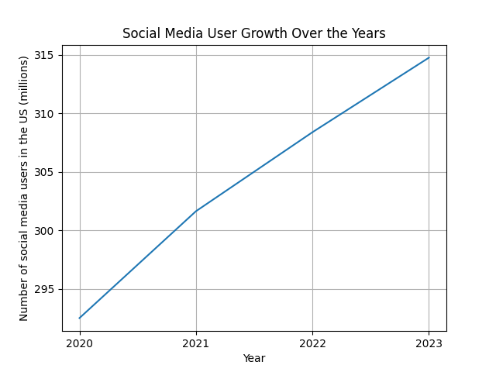
The Graph

Slide 7
02
In-depth Statistics

Slide 8
Social Media Users in the US by Age in 2023
Source: EMARKETER
Age Group | Number of Users (millions) | Percentage (%)¹
Baby Boomers (1946-1964) | 36.9 | 11.7
Gen X (1965-1980) | 51.8 | 16.5
Millennials (1981-1996) | 56.4 | 17.9
Gen Z (1997-2012) | 68.5 | 21.8
Others² | 101.2 | 32.10
1. Number of total users taken from the previous section
2. Includes users from other age groups, users who never specified their age, etc.

Slide 9
The CSV File
"Age Group", "Percentage"
Baby boomers, 11.70%
Gen X, 16.50%
Millennials, 17.90%
Gen Z, 21.80%
Others, 32.10%

Slide 10
The Code
import matplotlib.pyplot as plt
import pandas as pd
df = pd.read_csv('social media use by age.csv')
percentage = df['Percentage'].str.rstrip('%').astype('float')
age_groups = df['Age Group'].tolist()
plt.figure(figsize=(8, 8))
plt.pie(percentage, labels=age_groups, autopct='%1.1f%%', startangle=0)
plt.axis('equal')
plt.title('Distribution of Age Groups')
plt.show()

Slide 11
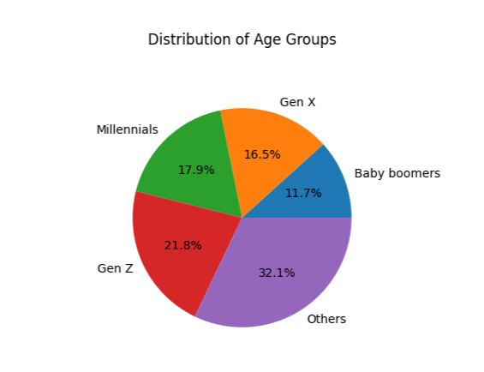
The Graph

Slide 12
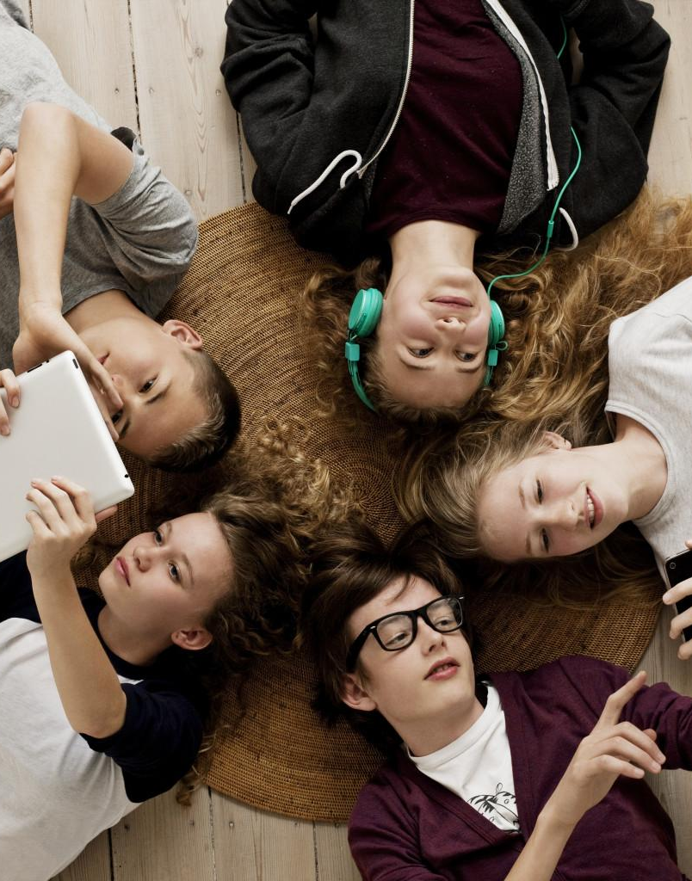
Conclusion
Disregarding the number of users in the “Others” category, we can conclude that Gen Zs in the United States consume the most social media compared to other age groups.

Slide 13
Thank You!

